Slide 1
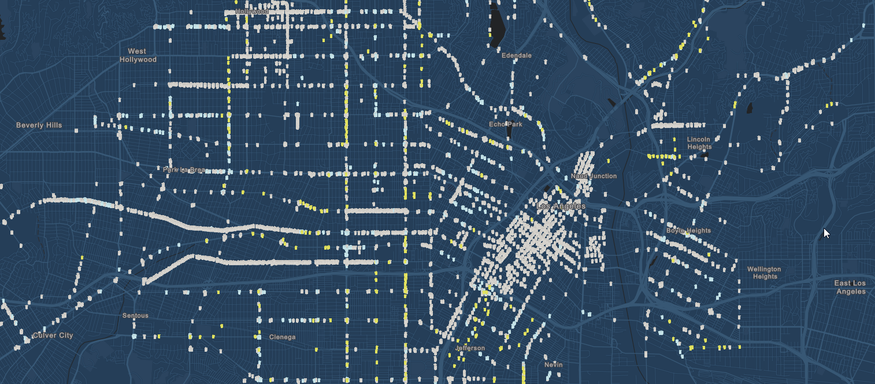
Violent Crime Trends in Los Angeles, CA
Los Angeles, CA
From 2010 to 2018.
J. Heston, S. Saha, E. Trittipo.

Slide 2
Project Requirements
The technical requirements for Project 1 are as follows.
Use Pandas to clean and format your data set(s)
Create a Jupyter Notebook describing the data exploration and cleanup process
Create a Jupyter Notebook illustrating the final data analysis
Use Matplotlib to create a total of 6-8 visualizations of your data (ideally, at least 2 per "question" you ask of your data)
Save PNG images of your visualizations to distribute to the class and instructional team, and for inclusion in your presentation
Optionally, use at least one API, if you can find an API with data pertinent to your primary research questions
Create a write-up summarizing your major findings. This should include a heading for each "question" you asked of your data, and under each heading, a short description of what you found and any relevant plots.

Slide 3
Flow of our presentation
Questions
Data Sources
Data Cleaning & Technical applications
Results
Conclusions

Slide 4
Questions

Slide 5
Data Sources

Slide 6
Data Cleaning & Technical applications

Slide 7
Results

Slide 8
Conclusions

